Slide 1
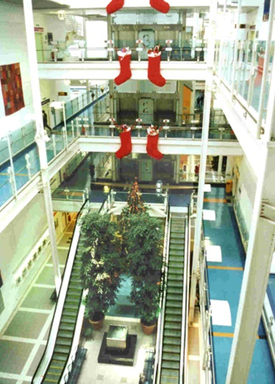
Imperial College
London
Intrapartum Surveillance
of the Fetus
Clinical features of concern -
Meconium and pyrexia
P J Steer
Emeritus Professor of Obstetrics
Academic Department of Obstetrics and Gynaecology
Chelsea and Westminster Hospital

Slide 2
Percent of 342 Intrapartum stillbirths associated with abnormal CTG, meconium and pyrexia
Steer PJ et al. North West Thames data set N = 469,941

Slide 3
Meconium
Contents of the fetal bowel
Can be passed by the fetus into the amniotic fluid during labour
This passage depends on the development of the neural networks allowing bowel peristalsis, and the production of motilin in the bowel wall
Passage can be stimulated by fetal stress

Slide 4
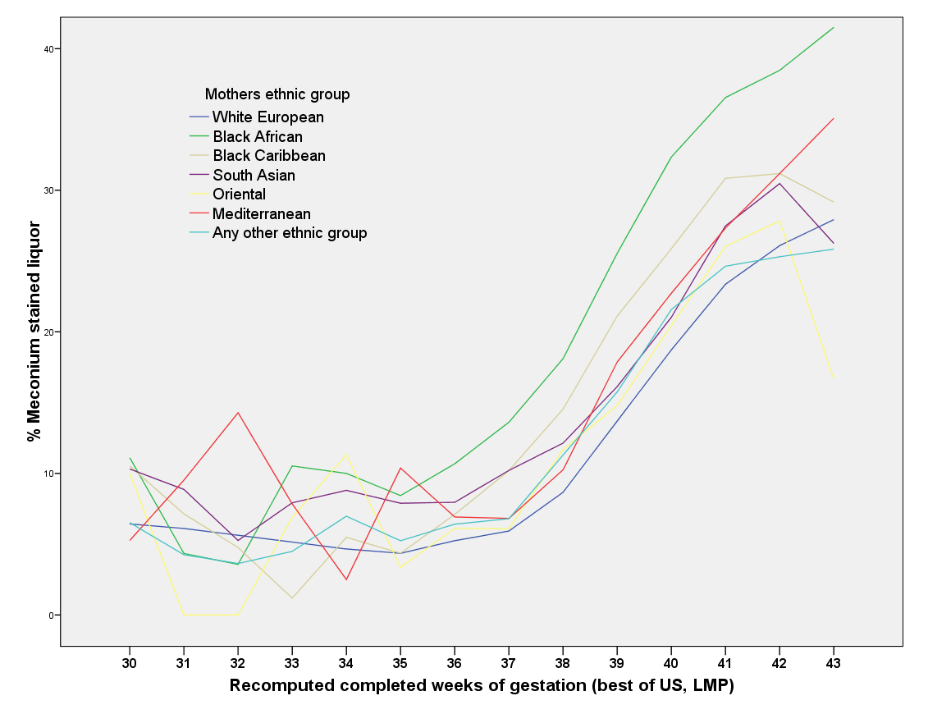
The major influence on the passage of meconium is maturation of the fetal bowel
Data on 473,429 labours, North West Thames, 1988-2000

Slide 5
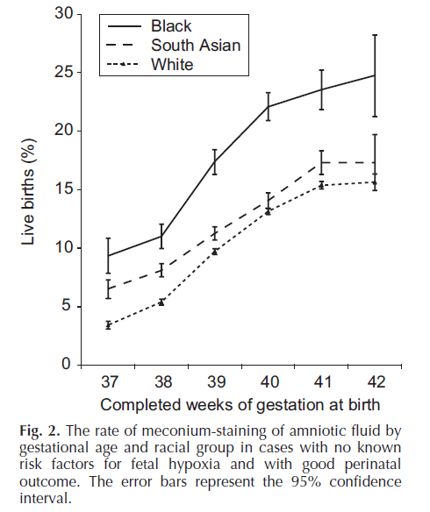
Balchin I, Whittaker JC,
Lamont RF, Steer PJ.
Maternal and fetal
characteristics associated
with meconium-stained
amniotic fluid: A study of
499,096 pregnancies
in North West London.
Obstet Gynecol 2011,
Apr;117(4):828-835

Slide 6
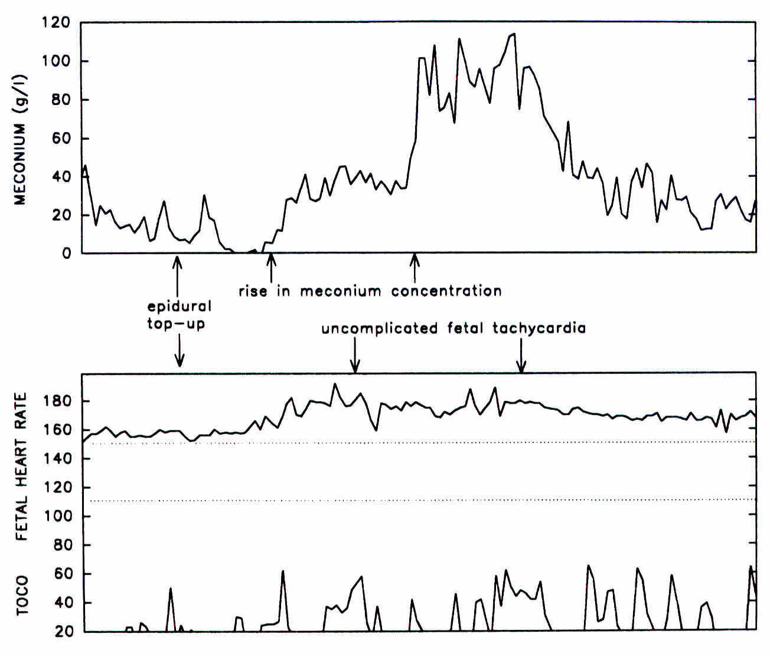
Fetal stress
and
meconium
E. S. Genevier, P. J. Danielian, N. J. Randall, R. Smith, and P. J. Steer.
A method for continuous monitoring of meconium in the amniotic fluid during labour.
J Biomed Eng 15 (3):229-234, 1993.

Slide 7
Effect of FHR pattern on meconium staining of the liquor

Slide 8
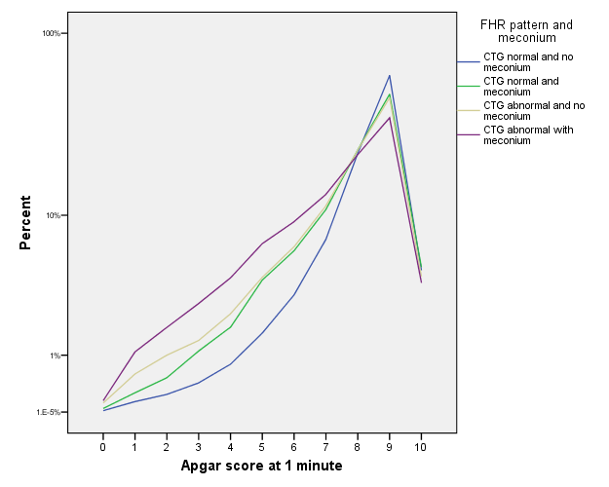
Interaction of CTG pattern with meconium
CTG abnormal,
meconium
CTG normal,
no meconium

Slide 9
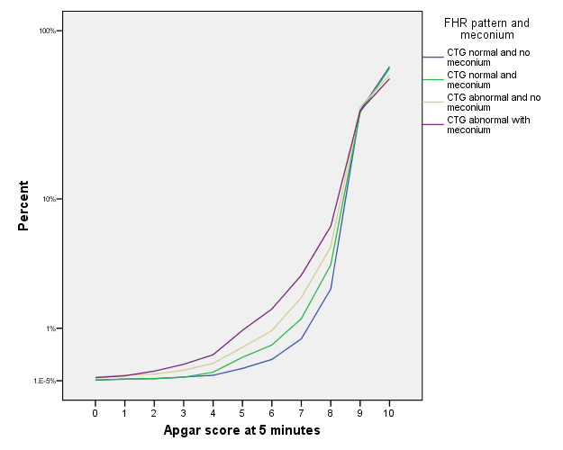
Interaction of CTG pattern with meconium
CTG abnormal,
meconium
CTG normal,
no meconium

Slide 10
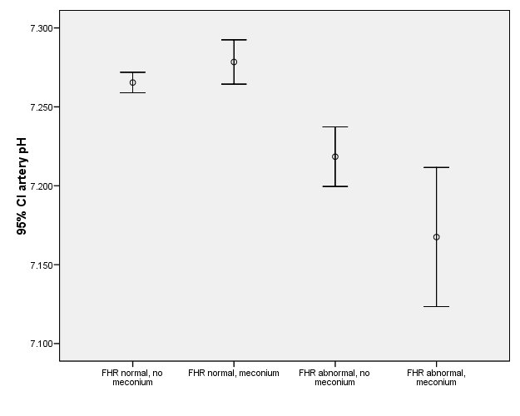
Interaction of CTG pattern with meconium in relation to acidosis
Steer P et al 1989 Obstet Gynecol 74;715-721

Slide 11
Interaction of CTG pattern with meconium - intubation
Steer PJ et al. North West Thames data set N = 469,376

Slide 12
Interaction of CTG pattern with meconium – intrapartum stillbirth
Steer PJ et al. North West Thames data set N = 469,376

Slide 13
Interpreting category II fetal heart rate tracings: does meconium matter?
3257 women with category II FHR tracings, 21.3% meconium, 78.7% no meconium
Adjusted odds ratio of neonatal death, neurologic morbidity, respiratory morbidity, hypotension that required treatment, and sepsis = 2.49
Frey HA, Tuuli MG, Shanks AL, et al. Am J Obstet Gynecol 2014;211:644.e1-8.

Slide 14
Conclusions (1)
Meconium passage during labour is primarily a function of fetal maturity
The presence of meconium in the liquor does not increase the risk of acidosis if the FHR pattern is normal
It does however increase the risk of meconium aspiration, especially in the presence of an abnormal FHR pattern
The biggest risk by far is the combination of an abnormal FHR pattern plus meconium plus acidosis

Slide 15
Conclusions (2)
No need for FBS,
Monitor FHR pattern
closely
Meconium, normal FHR pattern
No meconium, Abnormal FHR pattern
Consider FBS and pH
Meconium, Abnormal FHR pattern
Deliver

Slide 16
Pyrexia

Slide 17
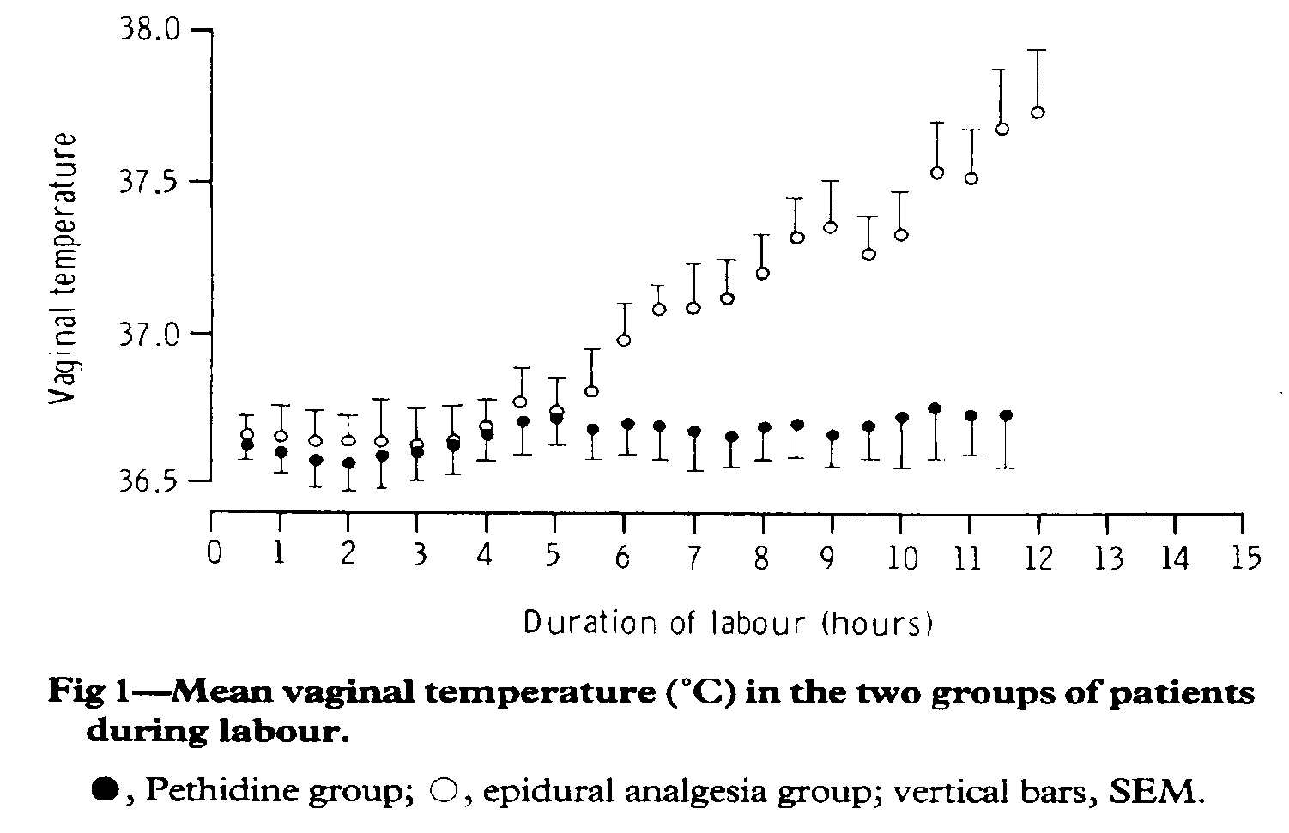
L. Fusi, P. J. Steer, M. J. A. Maresh, and R. W. Beard.
Maternal pyrexia associated with the use of epidural anaesthesia in labour.
Lancet i:1250-1252, 1989.

Slide 18
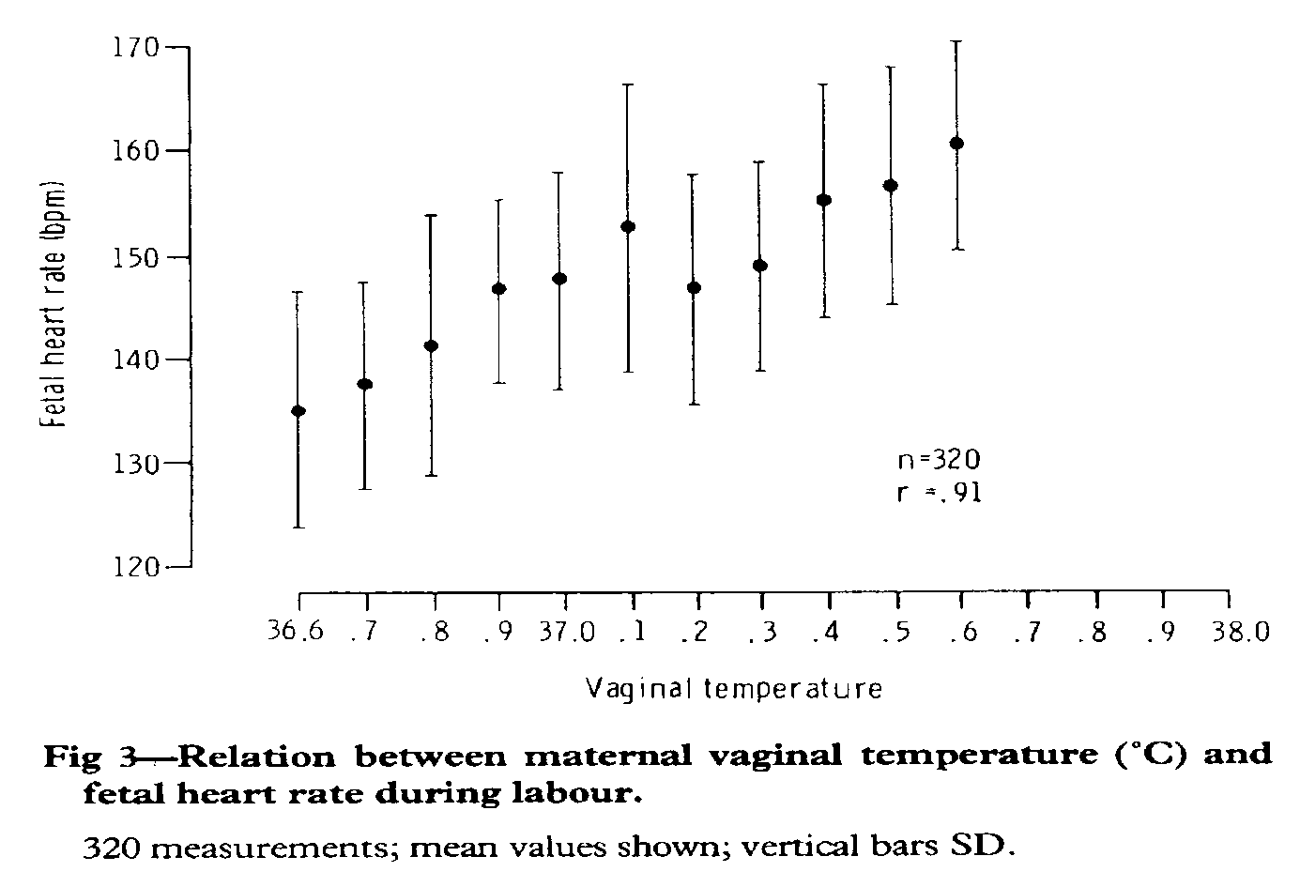
L. Fusi, P. J. Steer, M. J. A. Maresh, and R. W. Beard.
Maternal pyrexia associated with the use of epidural anaesthesia in labour.
Lancet i:1250-1252, 1989.

Slide 19
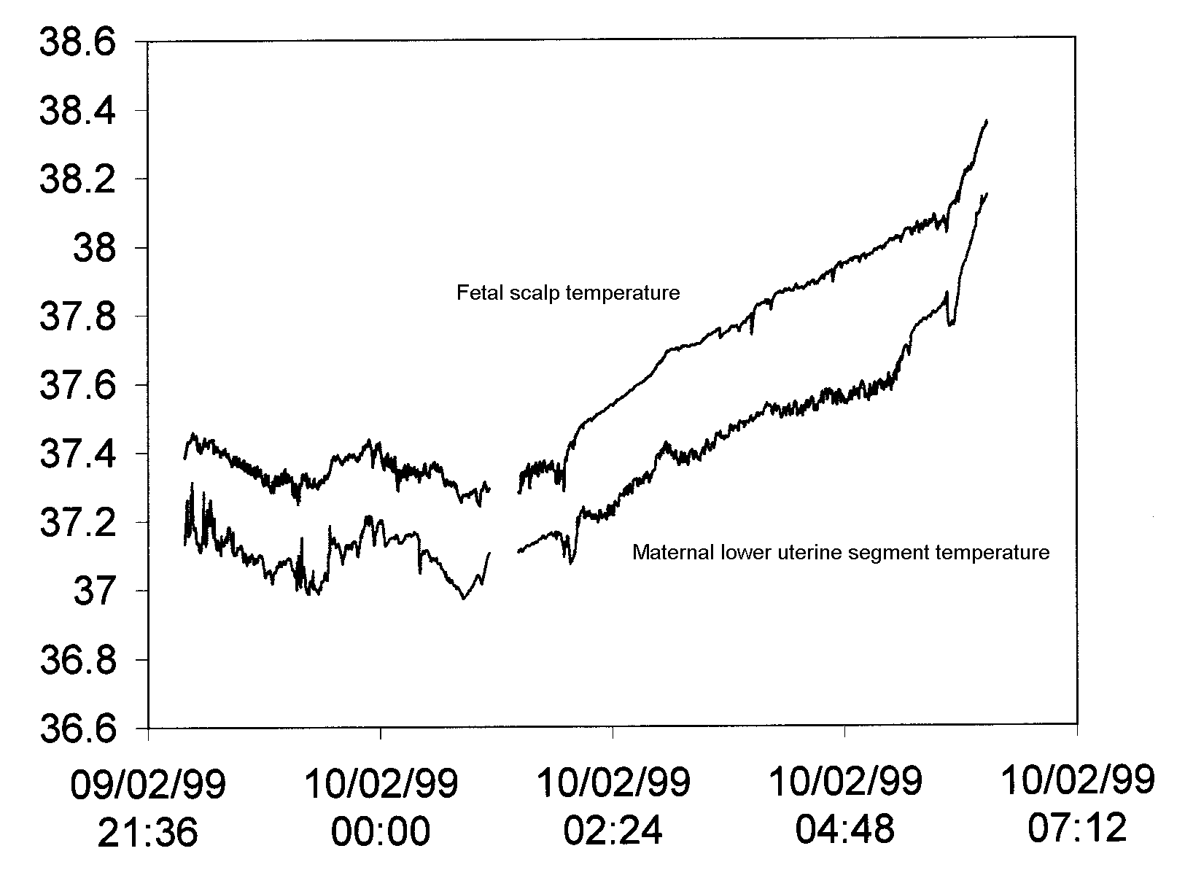
EPIDURAL

Slide 20
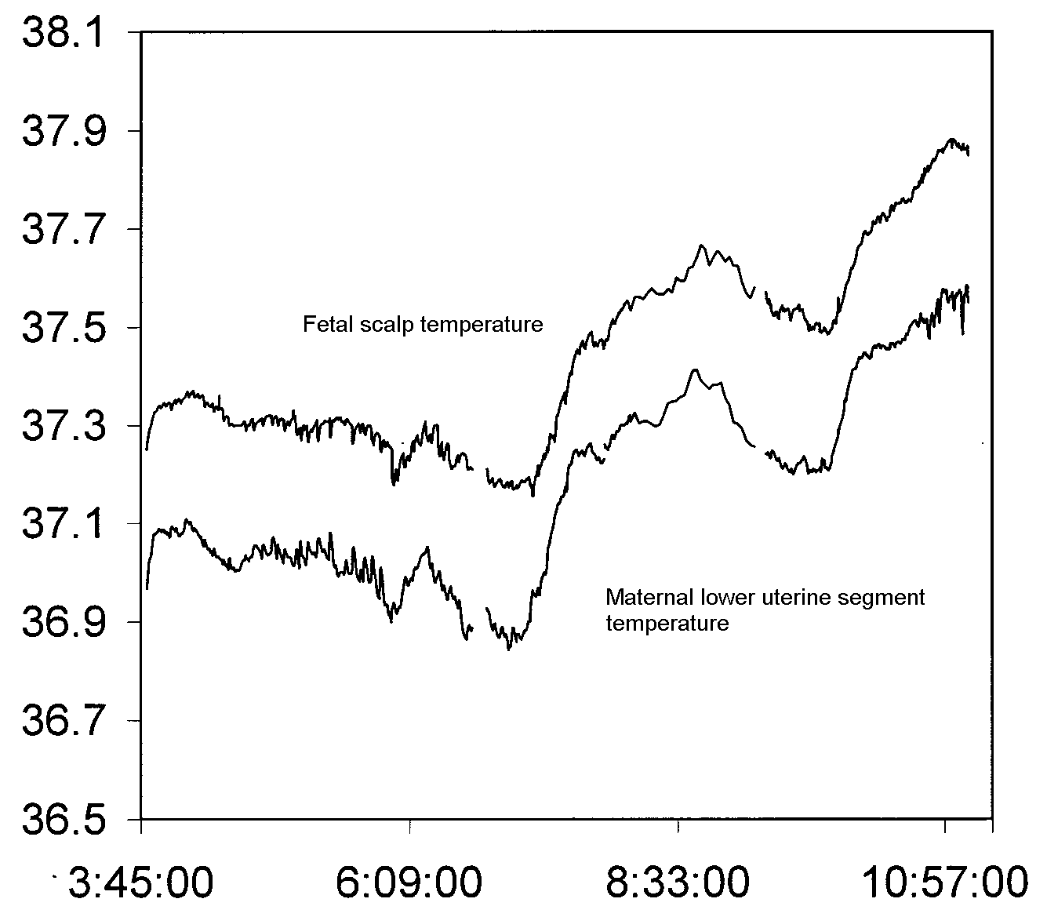
Top up
EPIDURAL

Slide 21
Epidural vs pyrexia

Slide 22
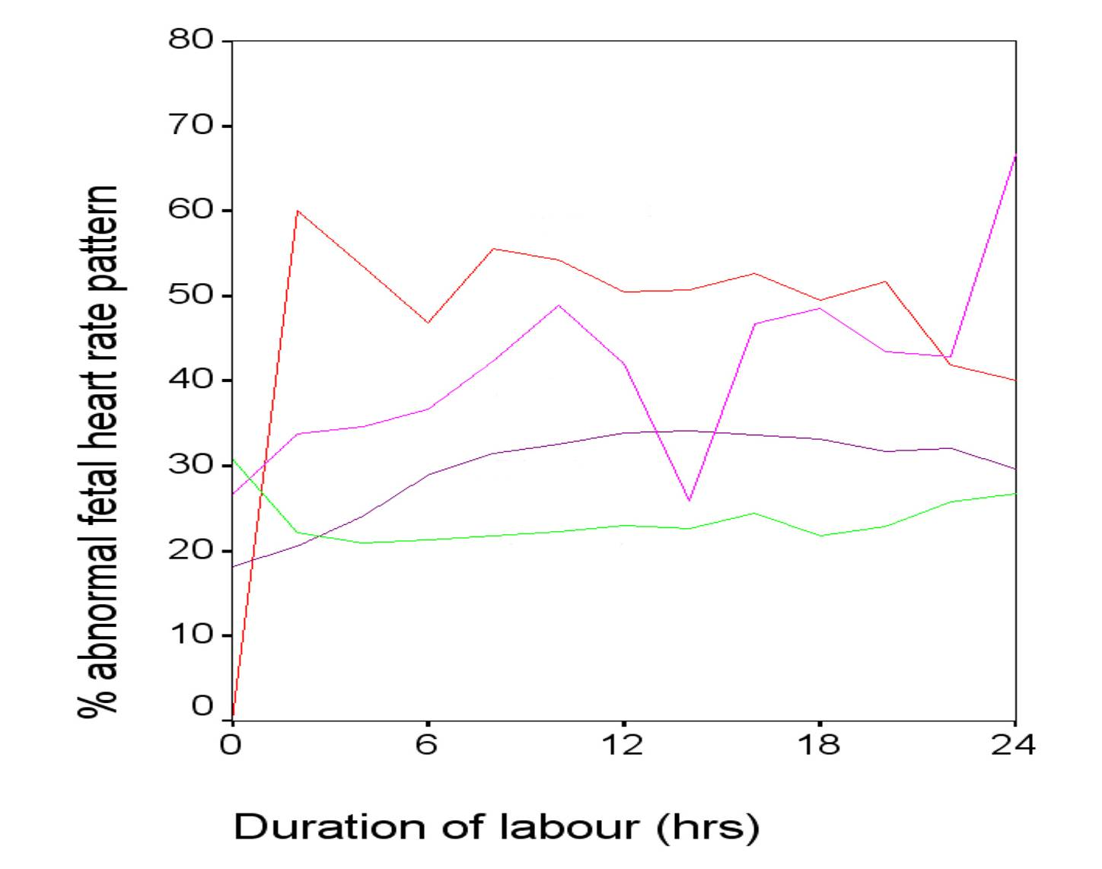
Duration of labour, epidural and pyrexia – incidence of abnormal FHR pattern
Epidural and pyrexia
Pyrexia but no epidural
Epidural but no pyrexia
No Epidural or pyrexia

Slide 23
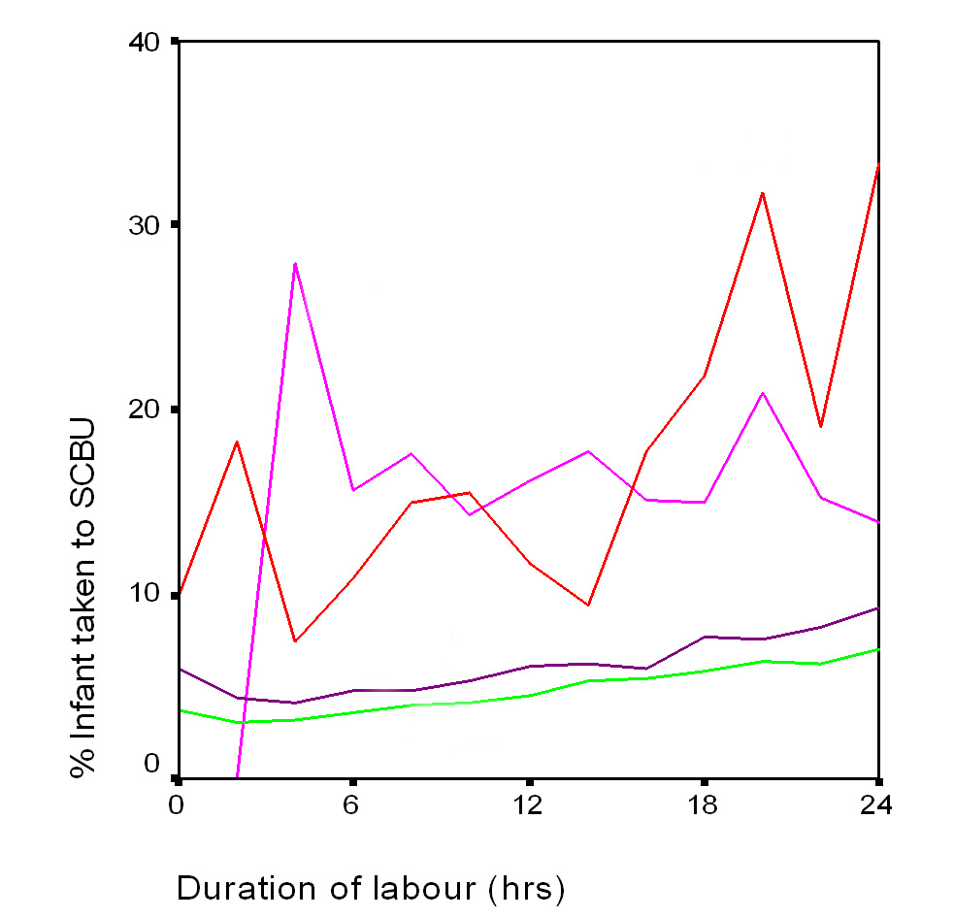
Epidural and pyrexia vs SCBU
Epidural and pyrexia
Pyrexia but no epidural
Epidural but no pyrexia
No Epidural or pyrexia

Slide 24
Perinatal outcome – multiple regression
 | Intrapartum or neonatal death | Neonatal convulsions
Overall | R = 0.009 p = 0.00003 | R = 0.007 p = 0.02
Epidural | p = 0.3 | p = 0.9
Duration of labour | p = 0.04 | p = 0.1
Pyrexia in labour | p = 0.000025 | p = 0.018

Slide 25
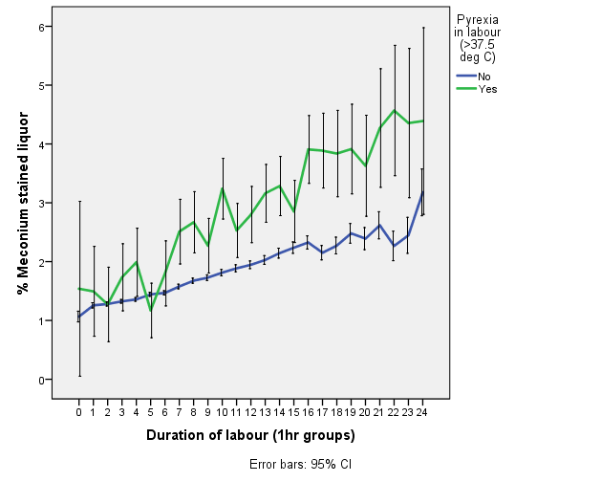

Slide 26
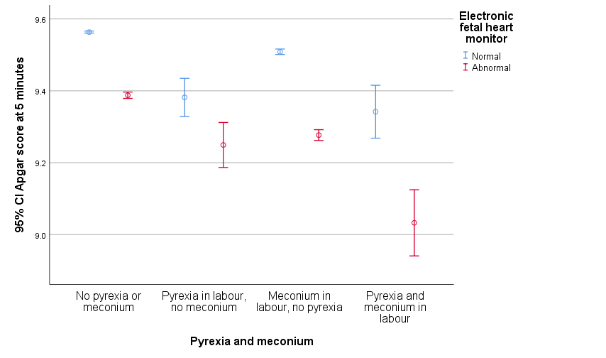
N = 395,499 4757 78984 2073

Slide 27
%

Slide 28
%

Slide 29
INTRAPARTUM MATERNAL FEVER
AND
CEREBRAL PALSY
“Maternal fever exceeding 38^{O}C in labor
was associated with an
increased risk of unexplained cerebral palsy
(odds ratio 9.3, 95% CI 2.7-31.0)”
J. K. Grether and K. B. Nelson.
Maternal infection and cerebral palsy in infants of normal birth weight.
JAMA 278 (3):207-211, 1997.

Slide 30
INTRAPARTUM MATERNAL FEVER
AND
NEONATAL ENCEPHALOPATHY
“Maternal pyrexia (odds ratio 3.82),
a persistent occipitoposterior position (4.29),
and an acute intrapartum event (4.44)
were all risk factors for
newborn encephalopathy”
N. Badawi, J. J. Kurinczuk, J. M. Keogh, L. M. Alessandri, F. O'Sullivan,
Burton, PR, P. J. Pemberton, and F. J. Stanley.
Intrapartum risk factors for newborn encephalopathy: the Western Australian case-control study.
BMJ 317 (7172):1554-1558, 1998.

Slide 31
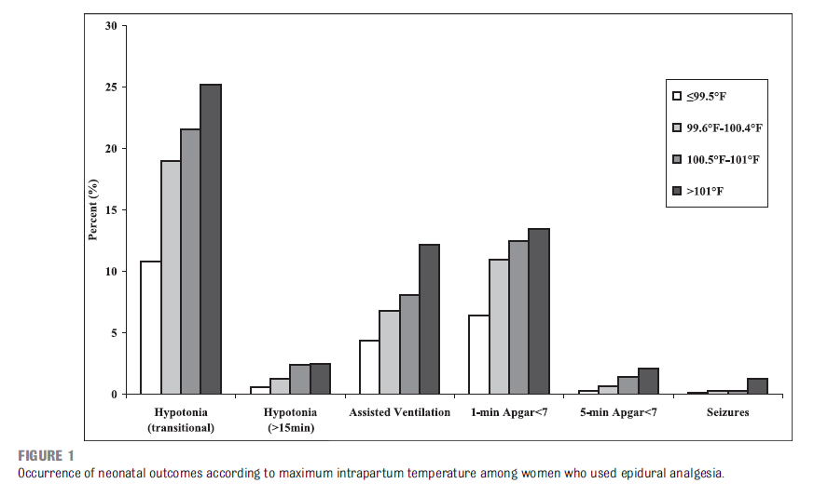
N=3,209
Epidural rate = 87%
Pyrexia with epidural = 45%
Without epidural =15%
Greenwell et al 2012, Pediatrics, 129:e447-e454

Slide 32
Epidural analgesia is a cause of intrapartum hyperthermia, and intrapartum hyperthermia of any cause is associated with neonatal brain injury.
Further work is required to establish if epidural-induced hyperthermia is a cause of neonatal brain injury.

Slide 33
1657 nulliparous women with term pregnancies and
singleton vertex fetuses who were afebrile at admission
%
E. Lieberman, J. M. Lang, F. Jr Frigoletto, D. K. Richardson, S. A. Ringer, and A. Cohen.
Epidural analgesia, intrapartum fever, and neonatal sepsis evaluation.
Pediatrics 99 (3):415-419, 1997.

Slide 34
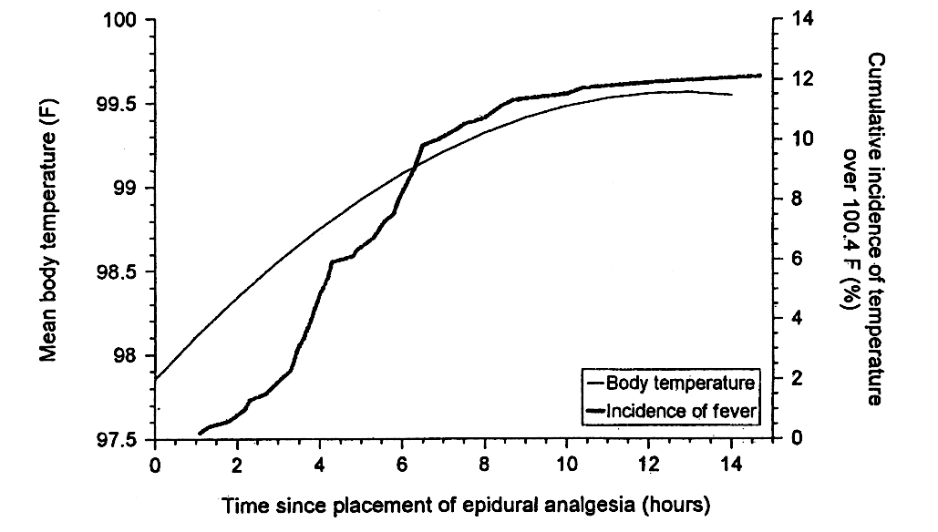
TRIPLER ARMY MEDICAL CENTER, HAWAII Epidural rate before October 1993 - 1%
After October 1993 - 83%
Temperature in labour > 37.5⁰C rose from 8.2% to 26.2%
Temperature > 38⁰C rose from 0.6% to 11%
M. K. Yancey, et al
epidural analgesia
and intrapartum
maternal hyperthermia.
Obstet Gynecol
98:763-770, 2001.

Slide 35
Scotland 2011
480 consecutive term singleton infants born to mothers who received EA in labor
480 controls without epidurals
 | Epidurals | Controls
Maternal Pyrexia >= 38⁰C | 11% | 0.8%
Neonatal pyrexia >=37.5⁰C | 14.2% | 3.1%
Neonatal sepsis workup | 11.7% | 2.5%
It is unnecessary to investigate febrile offspring of mothers who have had epidurals unless pyrexia persists for longer than 5 h or other signs or risk factors for neonatal sepsis are present
Agakidis C, Agakidou E, Philip TS, Murthy P, John LD.
Labor epidural analgesia is independent risk factor for neonatal pyrexia.
J Matern Fetal Neonatal Med 2011; 24(9):1128-1132.

Slide 36
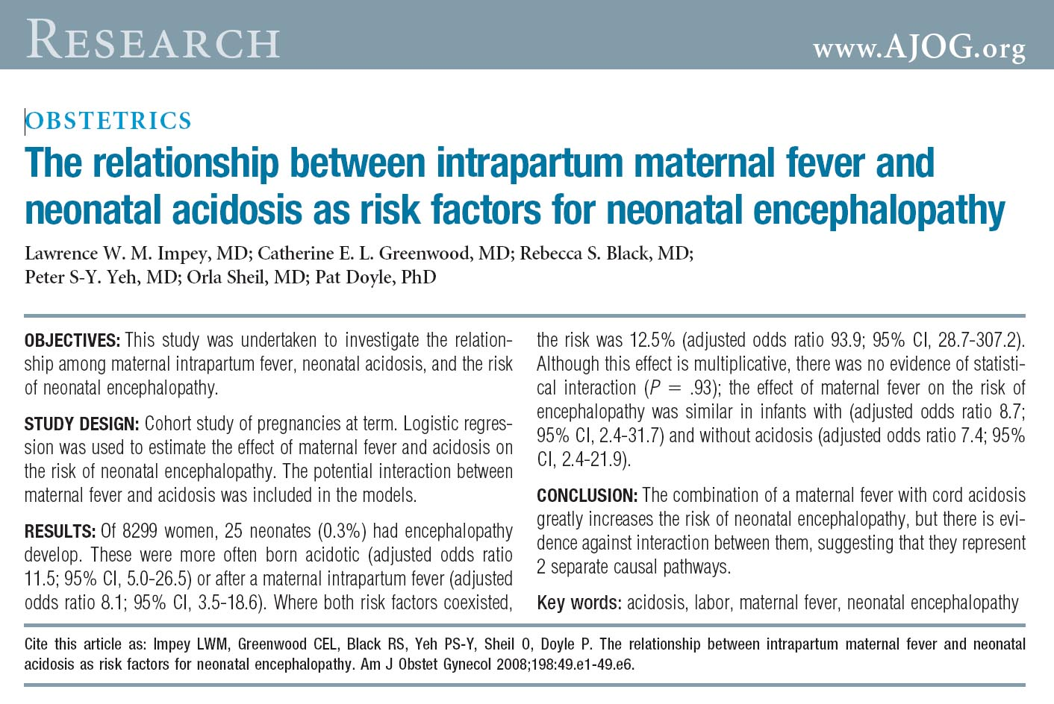
Where both factors coexisted, the risk was 12.5%.......

Slide 37
Randomized Trial of the Effects of Antibiotic Prophylaxis on Epidural-Related Fever in Labor
400 women with epidurals
200 given cefoxitin, 200 placebo
Incidence of fever >38ºC:
Antibiotics - 38%
Placebo - 40%
Sharma SK et al, Anesth Analg 2014;118:604–10

Slide 38
Conclusion
Pyrexia in labour is largely a function of labour duration and the use of epidurals
It is strongly associated with abnormalities of the FHR (especially tachycardia)
It is strongly associated with the need for admission to SCBU

Slide 39
Conclusion
Most intrapartum pyrexia in modern practice is associated with the use of epidurals, and is not usually due to infection; However:
Chorio-amnionitis must be considered, swabs taken, and antibiotics given if the pyrexia does not respond to simple cooling measures

Slide 40
Can we distinguish epidural from non-epidural fever?
In the presence of isolated fever, particularly in the late preterm and term patient after epidural analgesia, it may be appropriate to avoid antimicrobial agents and monitor the mother and neonate for additional signs or symptoms of infection.
Higgins RD, Saade G, Polin RA, Grobman WA, Buhimschi IA, Watterberg K et al. Evaluation and Management of Women and Newborns With a Maternal Diagnosis of Chorioamnionitis: Summary of a Workshop. Obstet Gynecol 2016; 127(3):426-436

Slide 41
Workshop on management of women and newborns with ? chorioamnionitis
“maternal fever alone should not automatically lead to a diagnosis of infection (or chorioamnionitis) and to antimicrobial therapy”.
Other criteria for IAP:
GBS +ve
Fetal tachycardia >160 for >10 mins
Maternal WBC >15,000 (no steroids)
Evidence of amniotic infection (clinical or amniocentesis)
Obstet Gynecol 2016;127:426–36

Slide 42
Can we find a way to prevent the rise in temperature caused by epidurals?

Slide 43
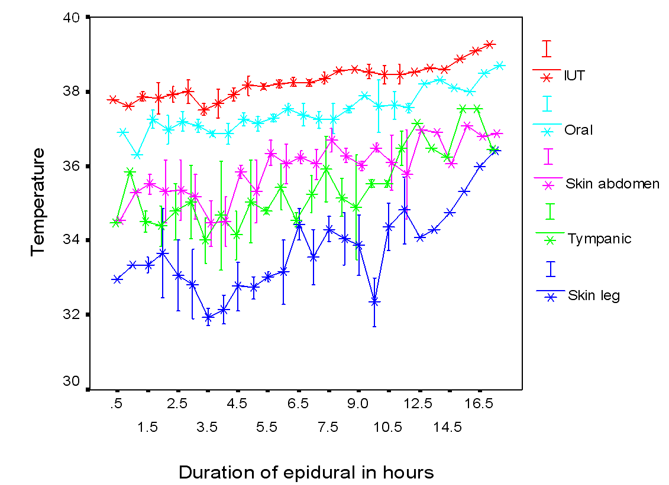
Mean temperature at different sites by duration of labour
S. Banerjee, P. Cashman, S. M. Yentis, and P. J. Steer.
Maternal Temperature Monitoring During Labor: Concordance and Variability Among Monitoring Sites.
Obstet.Gynecol. 103 (2):287-293, 2004

Slide 44
Effect of paracetamol
S. Banerjee, P. Cashman, S. M. Yentis, and P. J. Steer.
Maternal Temperature Monitoring During Labor: Concordance and Variability Among Monitoring Sites.
Obstet.Gynecol. 103 (2):287-293, 2004

Slide 45
Prophylactic acetaminophen does not prevent epidural fever in nulliparous women: a double-blind placebo-controlled trial.
42 women assigned at random to 650mg paracetamol PR immediately after epidural anaesthesia and then 4hrly until delivery
Maternal pyrexia >38ºC occurred in 25% of each group
There was no evidence of infection in either group
L. Goetzl, J. Rivers, T. Evans, D. R. Citron, B. E. Richardson, E. Lieberman, and M. S. Suresh.
J.Perinatol. 24 (8):471-475, 2004.

Slide 46
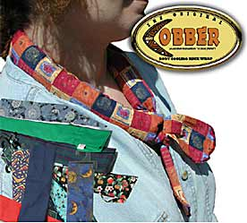
“A Cobber is a cooling neck wrap which can be worn around the neck or forehead. It actually reduces your body temperature by 3-4 degrees.”
http://www.coolgardenstuff.com/products2/prods/COBBER.html

Slide 47

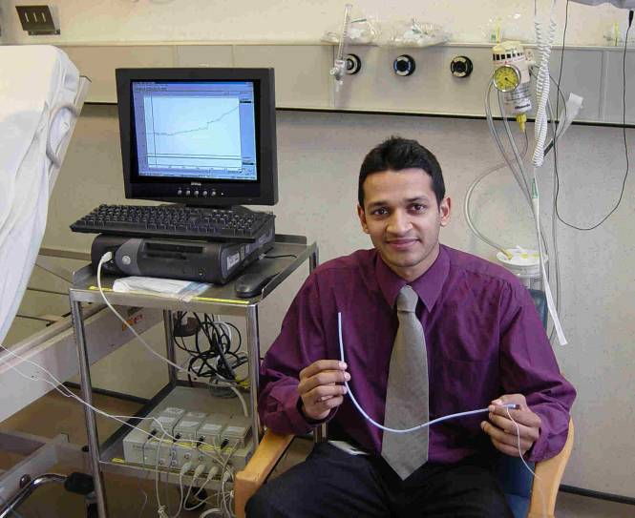
Vaibhav Sharma Neck Cooler study
March
2004

Slide 48
Neck
Cooler
Case
1

Slide 49
FHR 175bpm
Meconium ++
Maternal Shivering
+++
Neck coolers
FBS pH 7.39
Case
4
Top-up
Felt
Cold

Slide 50
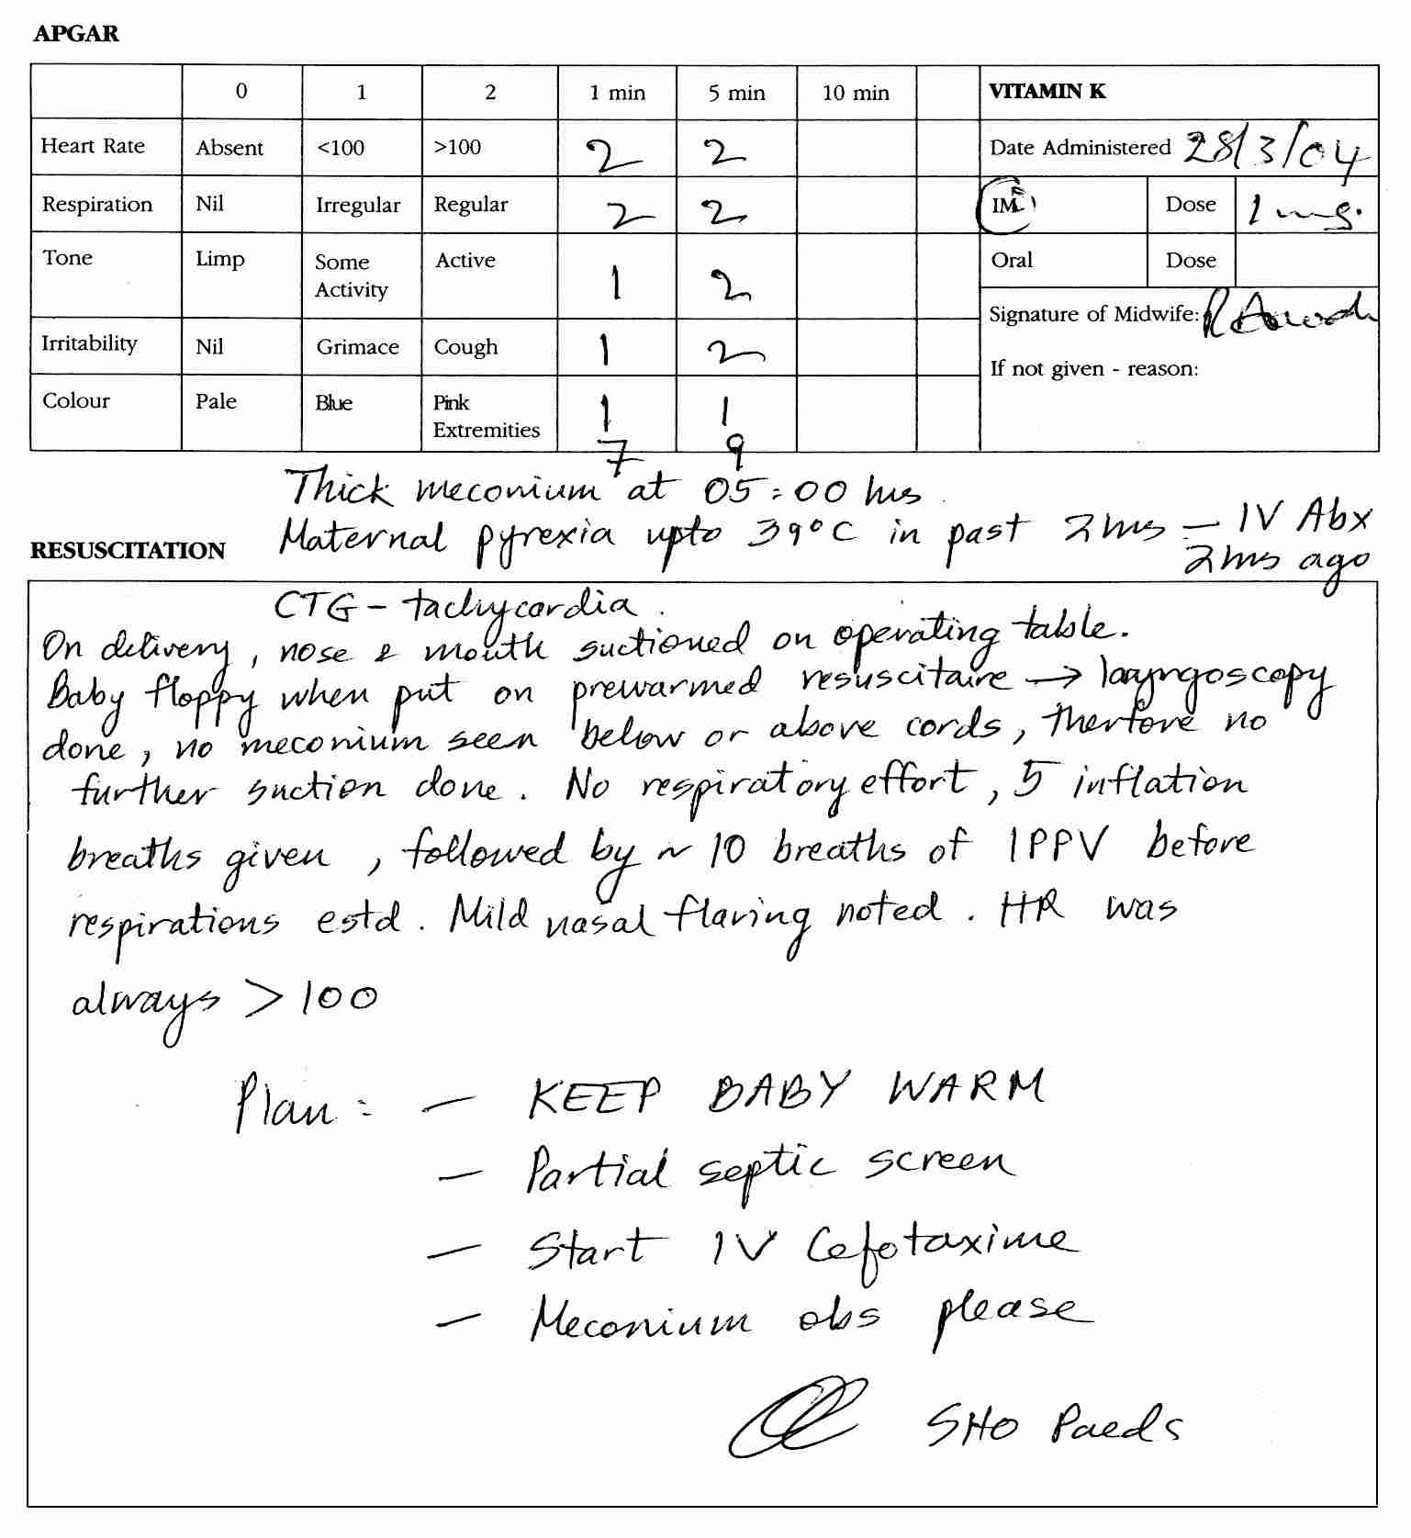
Resuscitation
of the baby
in case 4

Slide 51
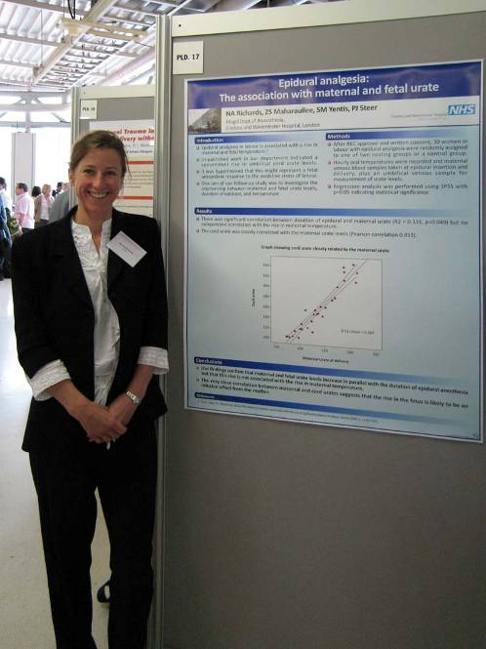
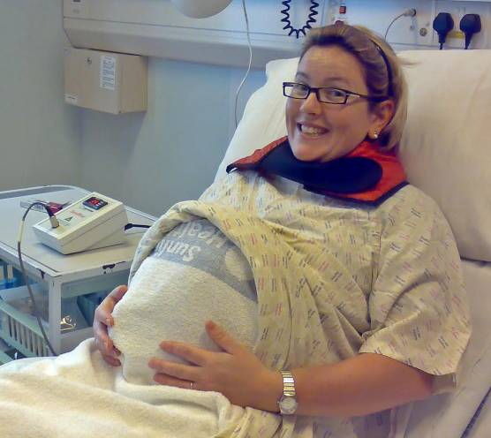
N A Richards, Z S Maharoullee, S M Yentis, P J Steer
Pilot study of neck warmers 2008

Slide 52
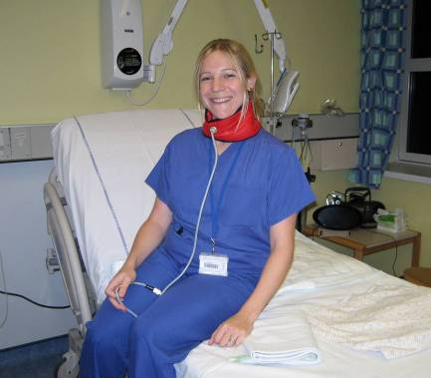
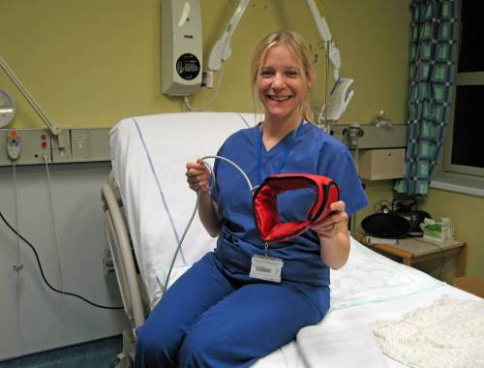
Tabitha Tanqueray
Results in first 70 cases

Slide 53
No Collar, N=35, P=0.005

Slide 54
Collar worn > 50% of the time, N = 20, p = 0.915

Slide 55

SHIVERING
Epidurals commonly cause shivering
May be due to lack of warm signals
 | Shivering | No Shivering
Controls | 14 | 20
Neck warmer | 6 | 29
P = 0.036

Slide 56
Research ongoing into:
Best temperature and
best site for warming
Epidural analgesia,
intrapartum hyperthermia, and
neonatal brain injury:
a systematic review and
meta-analysis.
Morton S, Kua J, Mullington CJ.
Br J Anaesth. 2021;126(2):500-515.

Slide 57
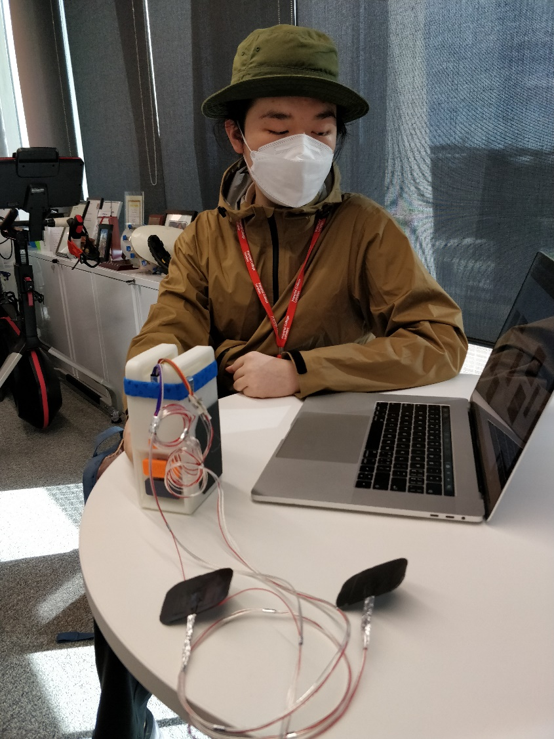
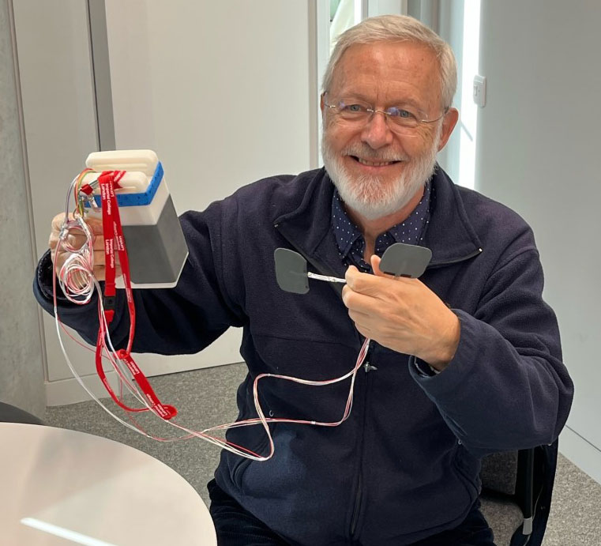
Wang
Xianghao

Slide 58
Conclusions
With epidural analgesia, maternal temperature rises by about 1⁰C every 8 hours
Fever in labour is strongly associated with adverse neonatal outcomes
It is clinically important to monitor maternal temperature in labour carefully, especially if there is prolonged ROM or use of epidural analgesia

